Slide 1



Introduction to Fake News Detection
By Adarsh Patel, Vikash Tiwari
and Sankalp Srivastav
.
Under the guidance of
Mrs. Naina Devi

Slide 2
Outline
Introduction to Fake News Detection
Understanding the Spread of Misinformation
The Role of Machine Learning in Fake News Detection
Feature Engineering for Fake News Classification
Supervised Learning Approaches
Unsupervised Learning Techniques
Evaluating Fake News Detection Models
Challenges and Limitations
Real-World Applications and Case Studies
Conclusion and Future Directions

Slide 3
Introduction to Fake News
Detection
Fake news detection is a crucial field, safeguarding against misinformation and promoting reliable information. In the digital age, the spread of false information is a growing concern, impacting public opinion and decision-making

Slide 4

Understanding the Spread of Misinformation
1
Creation & Sharing
Misinformation often originates from individuals or groups with malicious intent, and is spread through social media platforms, blogs, and websites.
2
Echo Chambers
People tend to consume information from sources that align with their existing beliefs, reinforcing biases and making them more susceptible to misinformation.
3
Viral Propagation
Once misinformation gains traction, it spreads rapidly through social media, reaching a wider audience and amplifying its impact.

Slide 5
The Role of Machine Learning in Fake News Detection
Automatic Analysis
Real-time Detection
Adaptive Learning
Machine learning algorithms can process large volumes of text data, identifying patterns and anomalies that indicate fake news.
ML models can be deployed in real-time to detect and flag potentially fake news articles, reducing the spread of misinformation.
ML models can constantly learn and adapt to new patterns and techniques used by creators of fake news, improving their accuracy over time.

Slide 6
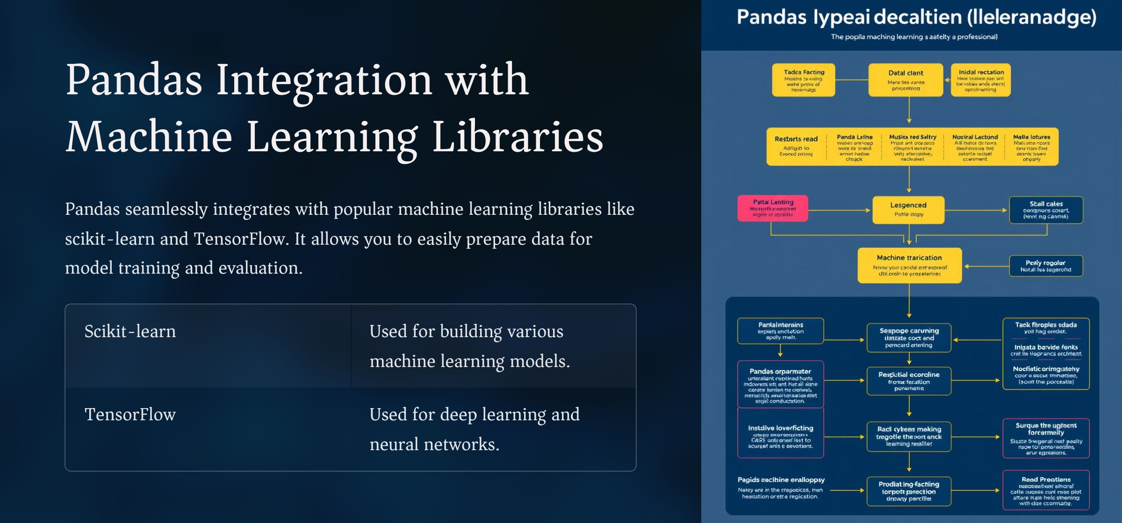

Slide 7
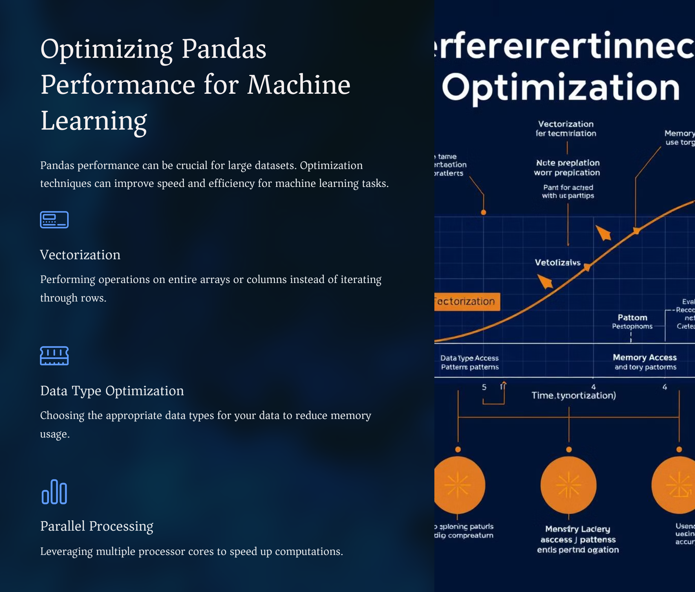

Slide 8


Slide 9


Slide 10
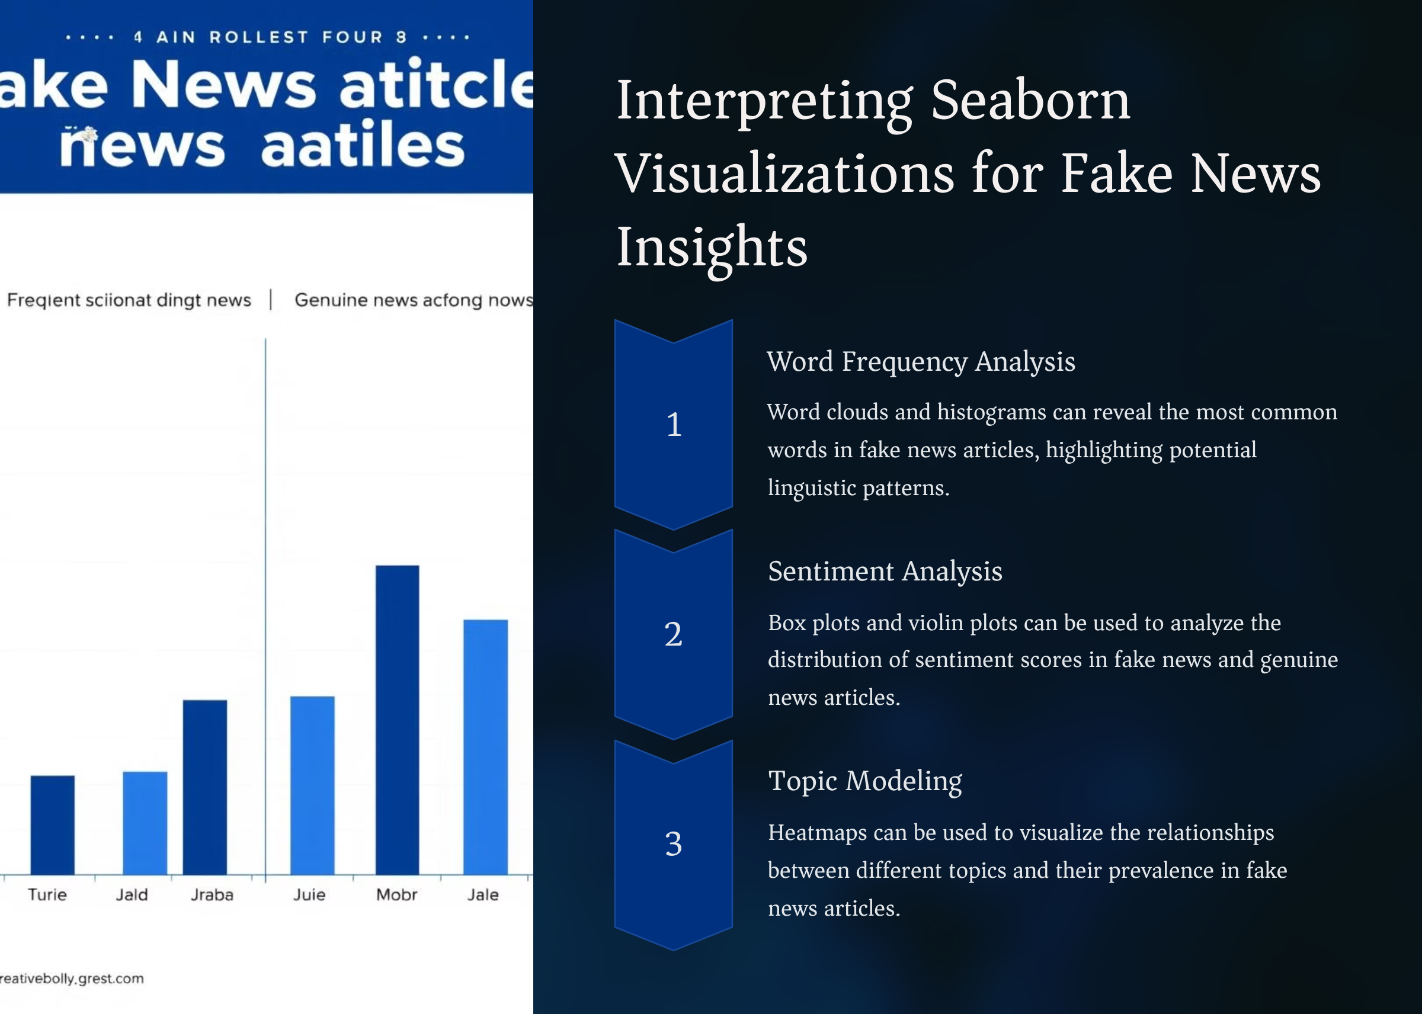

Slide 11
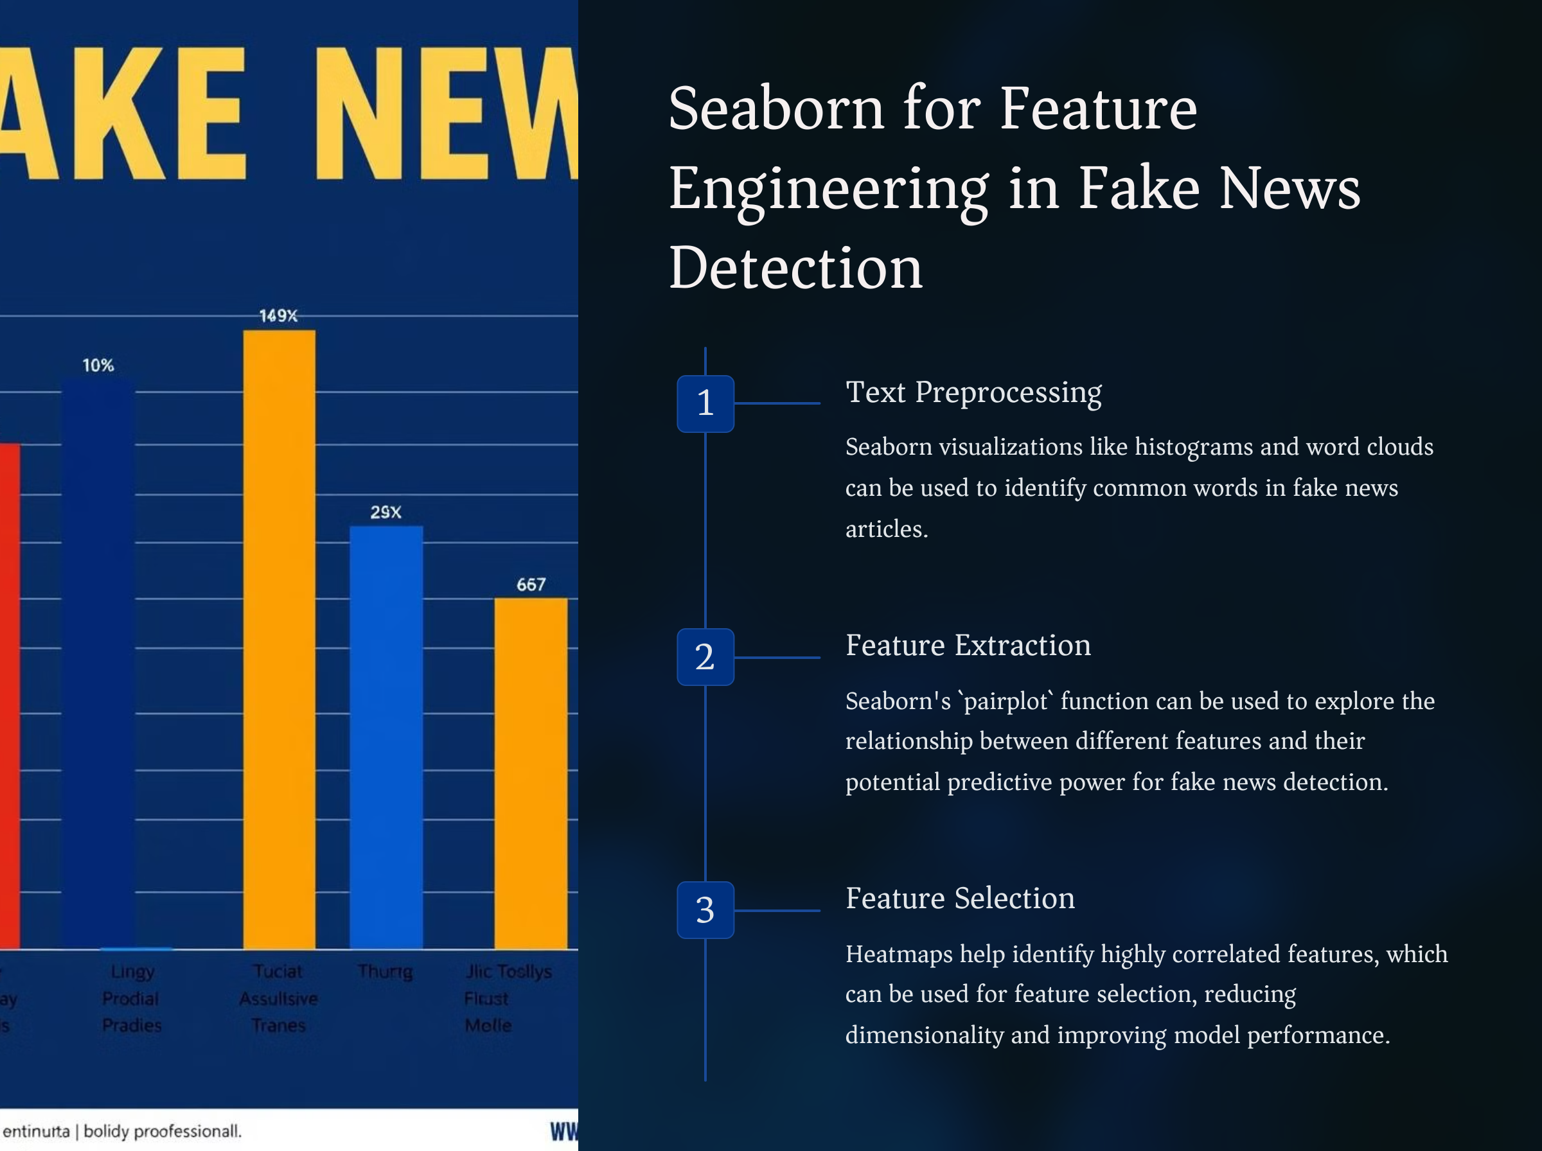

Slide 12
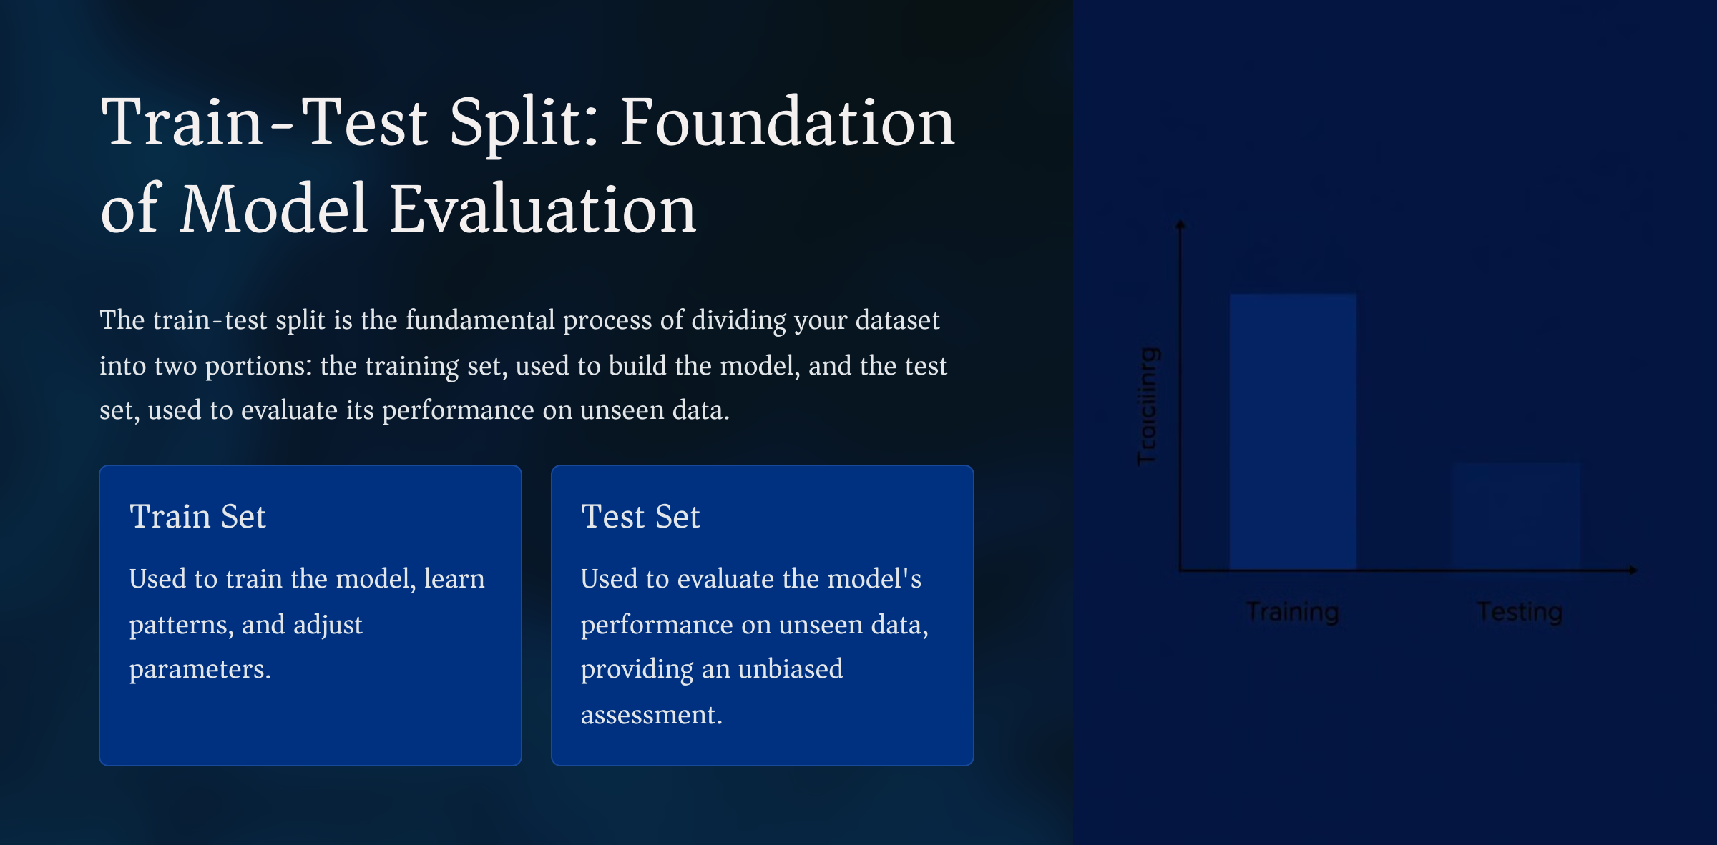

Slide 13
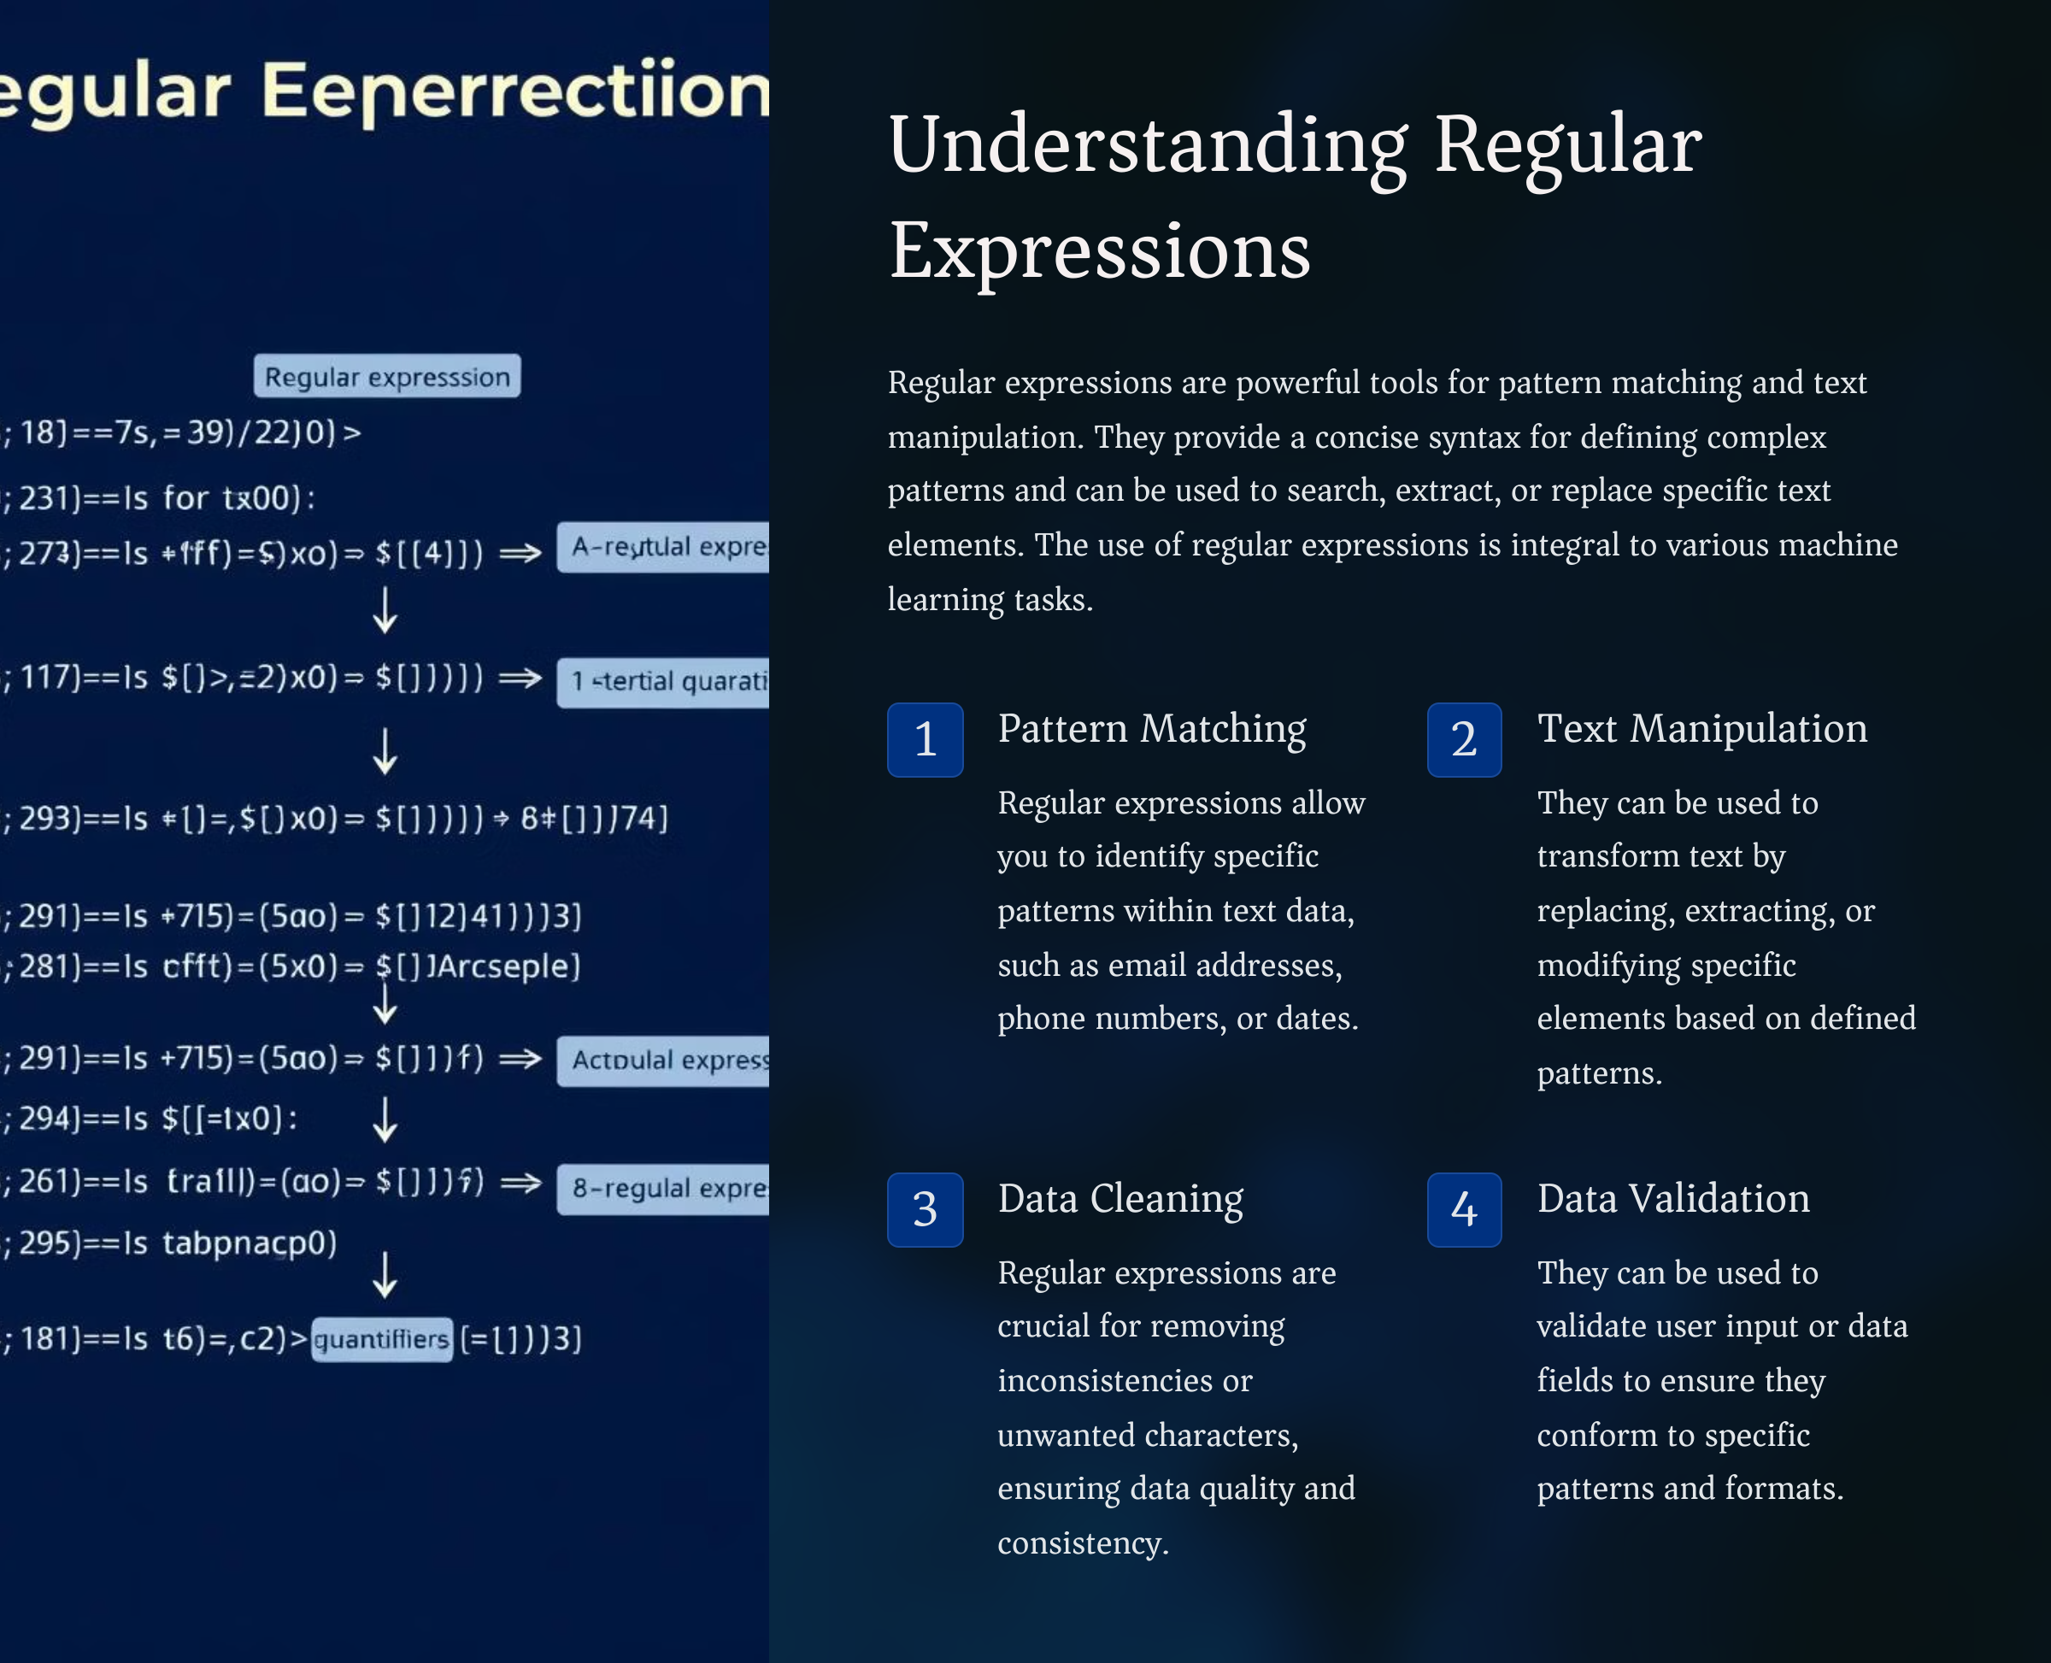

Slide 14


Slide 15
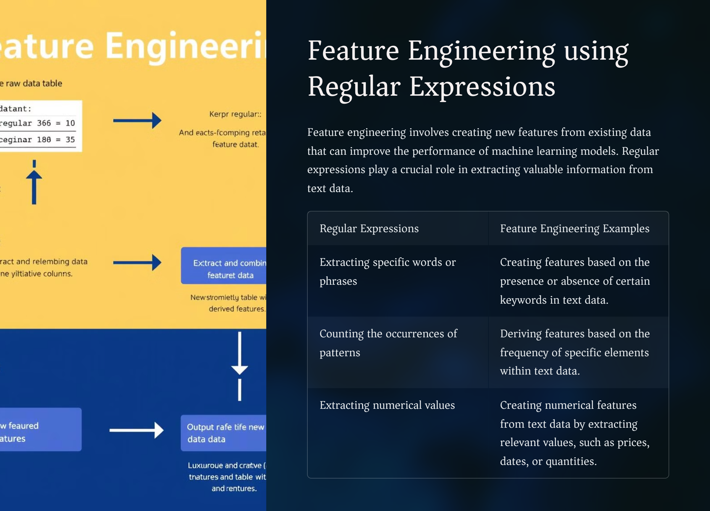

Slide 16
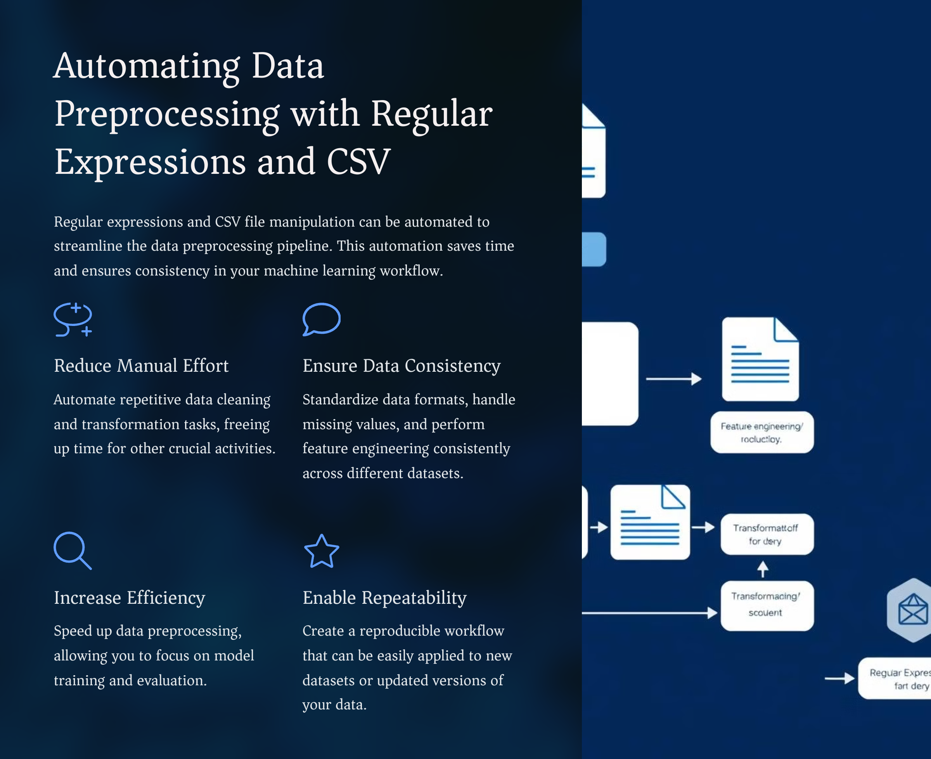

Slide 17
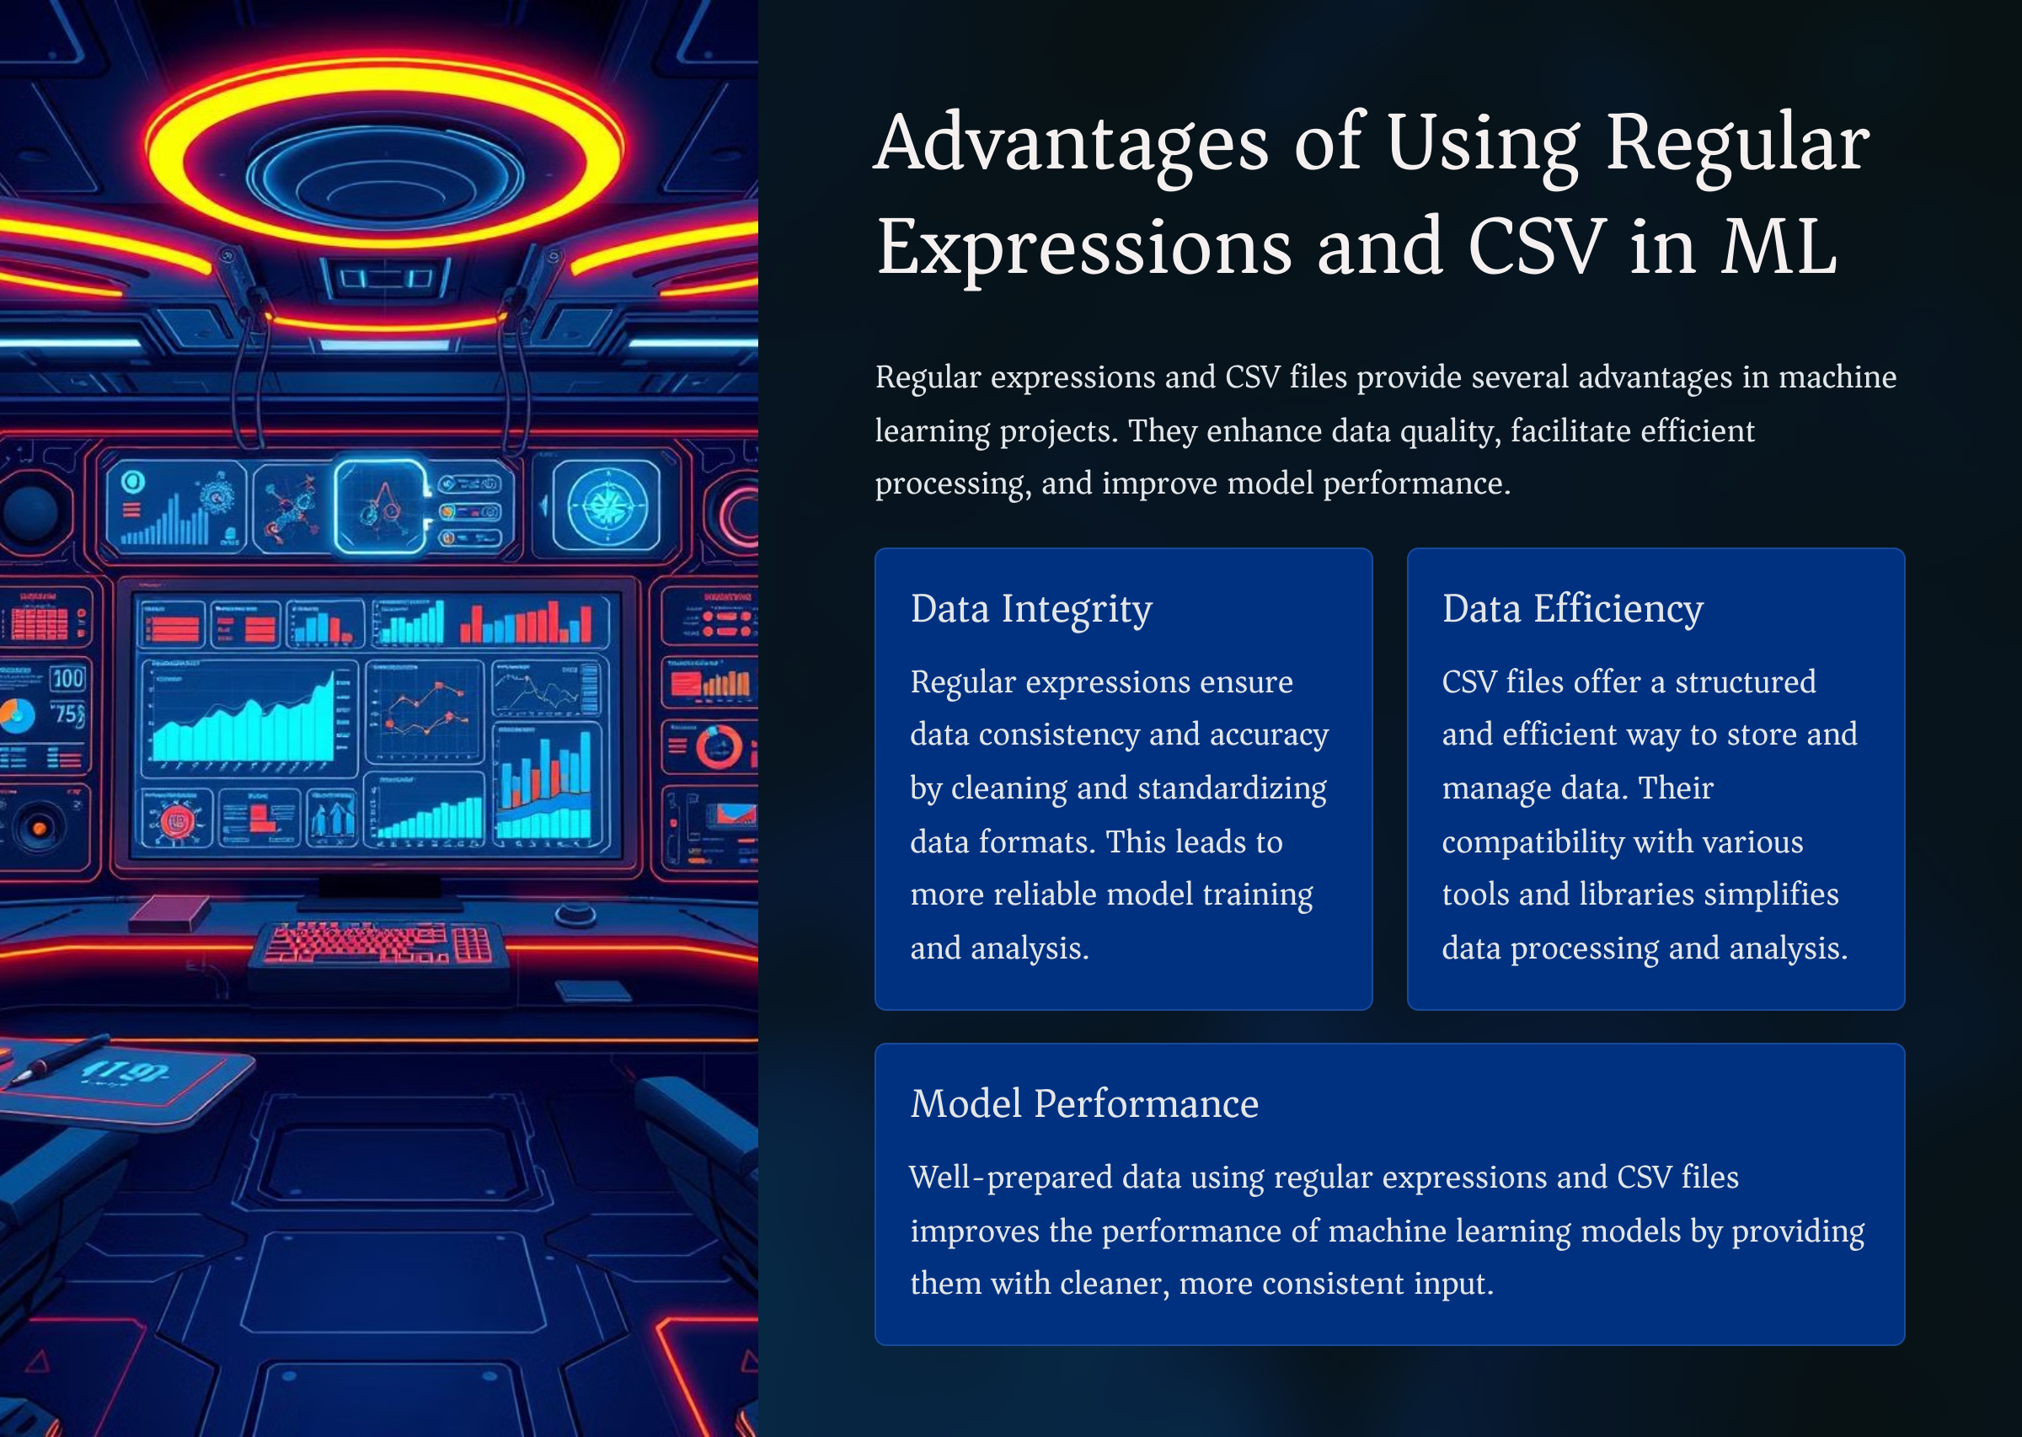

Slide 18

Feature Engineering for Fake News Classification
1
Textual Features
2
Source Credibility
Linguistic features like word choice, sentence structure, and use of emotional language can be indicators of fake news.
Information about the source of the article, such as its reputation and history, can be used to assess its reliability.
3
Social Media Signals
4
Visual Content
The way an article is shared and interacted with on social media can be indicative of its authenticity.
The presence of manipulated or misleading images or videos can be a red flag for fake news.

Slide 19
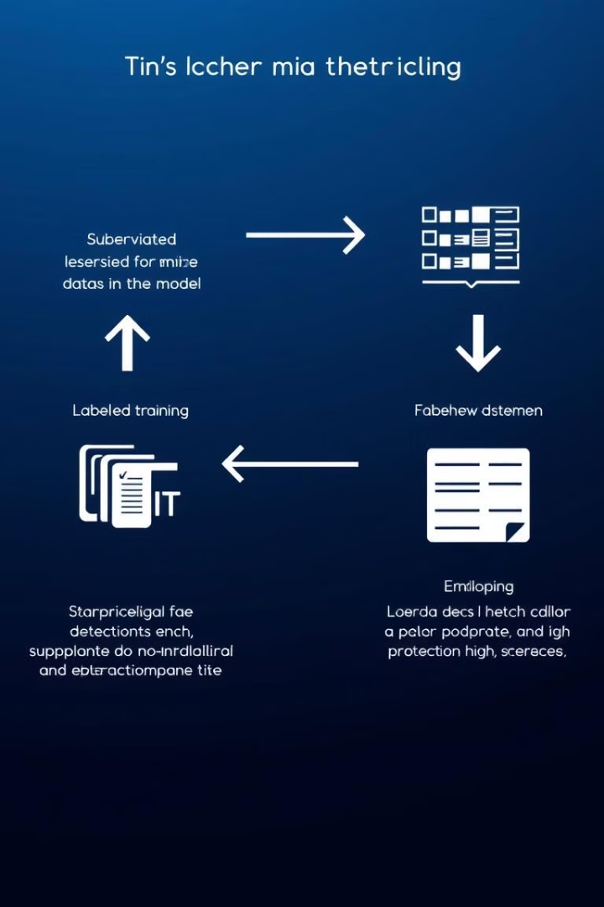
Supervised Learning Approaches
Classification Algorithms
Neural Networks
Algorithms like Naive Bayes, Support Vector Machines, and Logistic Regression can be trained on labeled datasets to classify articles as fake or real.
Deep learning models, such as recurrent neural networks (RNNs) and convolutional neural networks (CNNs), can learn complex patterns from text data.
Ensemble Methods
Combining multiple machine learning models can improve the accuracy and robustness of fake news detection systems.

Slide 20




Unsupervised Learning Techniques
Clustering
Clustering algorithms can group similar articles together, potentially identifying clusters of fake news articles.
Anomaly Detection
Algorithms can detect articles that deviate significantly from typical patterns, potentially indicating fake news.
Topic Modeling
Topic modeling techniques can analyze the underlying topics in articles, helping to identify patterns associated with fake news.

Slide 21
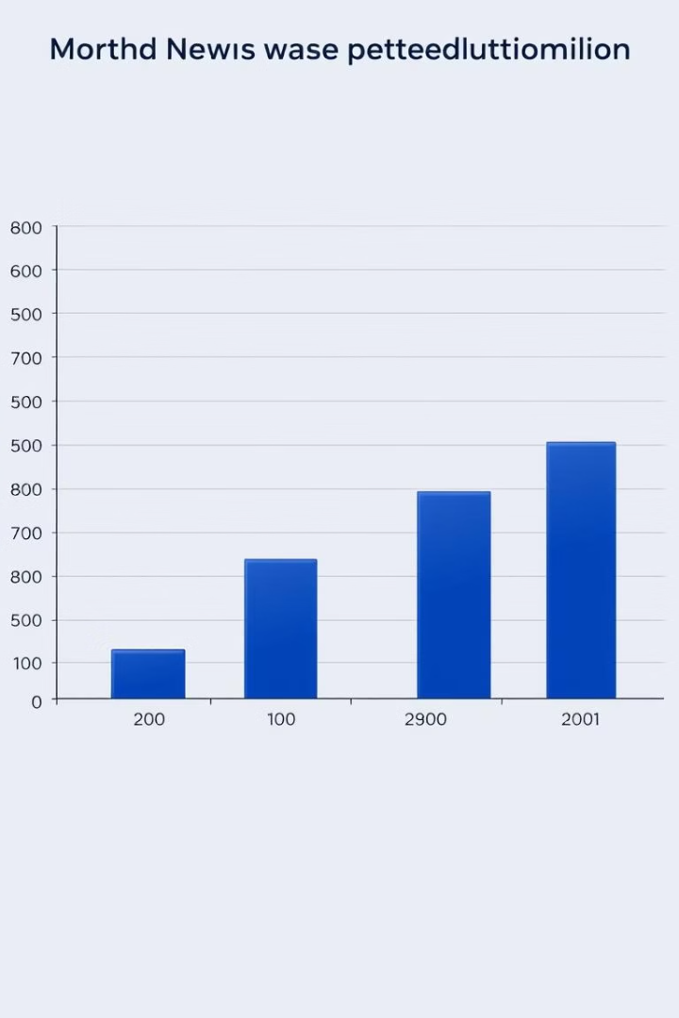
Evaluating Fake News Detection Models
Metric
Description
Accuracy
The overall proportion of correctly classified articles.
Precision
The proportion of correctly classified fake news articles among all articles classified as fake.
Recall
The proportion of correctly classified fake news articles among all actual fake news articles.
F1 Score
A balanced measure of precision and recall.

Slide 22





Challenges and Limitations
Evolving Techniques
Data Bias
Creators of fake news are constantly developing new techniques to evade detection, requiring ongoing adaptation of machine learning models.
Training data can be biased, leading to models that may be less effective at detecting certain types of fake news.
Cross-lingual Challenges
Ethical Considerations
Detecting fake news in multiple languages requires specialized models and datasets.
It's crucial to ensure that fake news detection systems are used responsibly and ethically, respecting privacy and avoiding censorship.

Slide 23


Real-World Applications and Case Studies
Social Media Platforms
News Organizations
Platforms like Facebook and Twitter use machine learning to identify and flag fake news articles, reducing their spread.
News organizations use machine learning tools to verify information and detect fake news, enhancing their credibility.

Slide 24

Conclusion and Future Directions
Fake news detection is a rapidly evolving field, with new challenges and opportunities emerging constantly. Future research will focus on improving model accuracy, addressing data bias, and developing robust systems that can effectively combat the spread of misinformation.

Slide 25
Thank You

